Slide 1
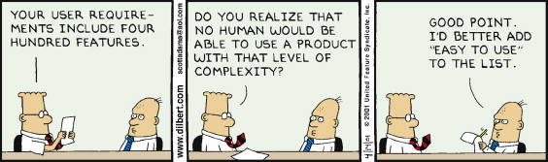
Storyboards
Prepared by G Khan

Slide 2
Origin and Purpose
Storyboards
Originated in and remain prevalent with the art & design community,
they are ultimately a practical tool.
The first documented use of storyboards in their modern form was by the team at Disney working on the ‘3 Little Pigs’ movie. Before that, the animators would work in a room together and just hope that all their hard work was on target and made sense together.

Slide 3
Purpose
Storyboards
are a kind of prototype - often referred to as the design prototype
something we create to bring our idea to life quickly and cheaply.
We use it to vet the idea before we waste time & money on something no one wants.
Software development is expensive and time consuming so making sure everyone knows what they want (and why) beforehand is important.

Slide 4
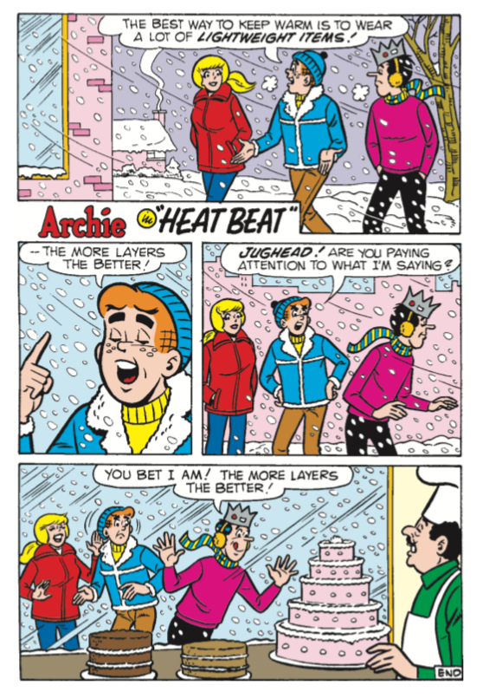
Storyboarding in Comics

Slide 5
Application
You can use storyboards for nearly anything that involves a description of one or more people doing something.
Storyboards can be used to
1. examine ideas for a new product or feature
2. narrate key user interactions
3. describe the customer acquisition process
4. map customer journeys
5. analyze the creation of user habits

Slide 6
Getting Started
1. Creating the Storyboarding Squares
2. Thinking Through the Narrative
3. Storyboarding Before and After Scenarios
Breaking Down the Story
Start the customer discovery process with personas– vivid depictions of your customers in context
These personas have problem scenarios- needs and desires they’d like to fulfill.
They also have current alternatives- things they doing (or not doing) about the problem scenario today.
You have a value proposition- something you’re going to offer that you hope is better enough than the current alternatives to win over the customer.

Slide 7
Storyboard an Epic User Story (Agile)
Start with the user stories
As a [persona], I want to [do something] so that I can [derive a benefit]”
Tie every major user story back to a vivid, real-world persona & problem scenario
make sure each story has all three clauses.
Include test cases as an additional layer of detail in the stories.

Slide 8
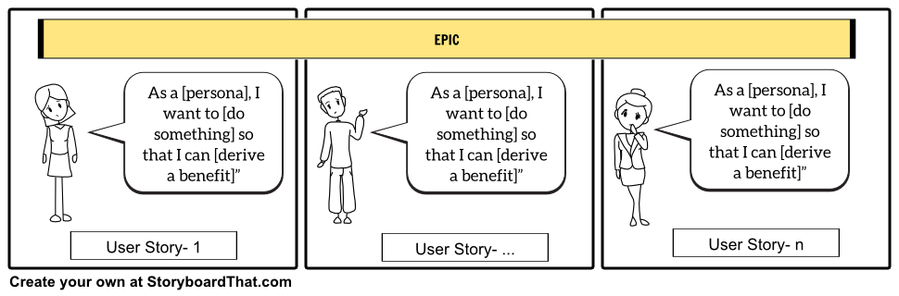
Storyboarding an Epic
Storyboard are a great way to humanize and describe epic stories
Detail the epic by adding notes at the bottom of each panel

Slide 9
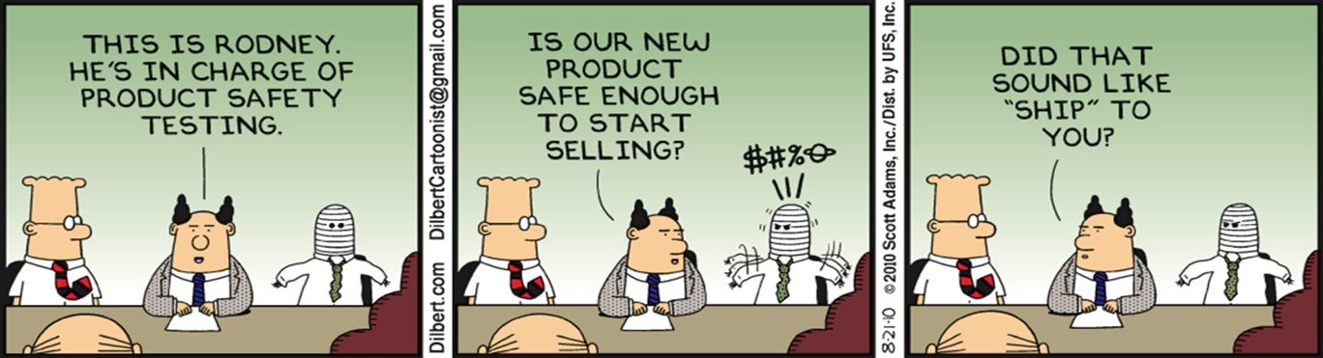
Additional reading
https://fivewhys.wordpress.com/2012/03/30/storyboarding/
https://www.wikihow.com/Draw-Storyboards
https://www.alexandercowan.com/storyboarding-tutorial/

